Slide 1
More on free writing

Slide 2
Refresh your writing
Pat Thomson (2022)
Patter

Slide 3
Pick one, write!
Make a list of all the things about your research that you find truly fascinating. Then choose one and write more about it
Write about what you love most about your research.
Find an everyday metaphor that captures an important aspect of your research process or findings, such as food, a staircase, fog, a box, a river, a key, a door, a rock, a mountain, a window, a knot...
Write about your research starting with the words, “If only...”
List the turning point or turning points in your research. Choose one and write about it.

Slide 4
The law of avoidance
Manson (2023) adapted by urdimbre

Slide 5
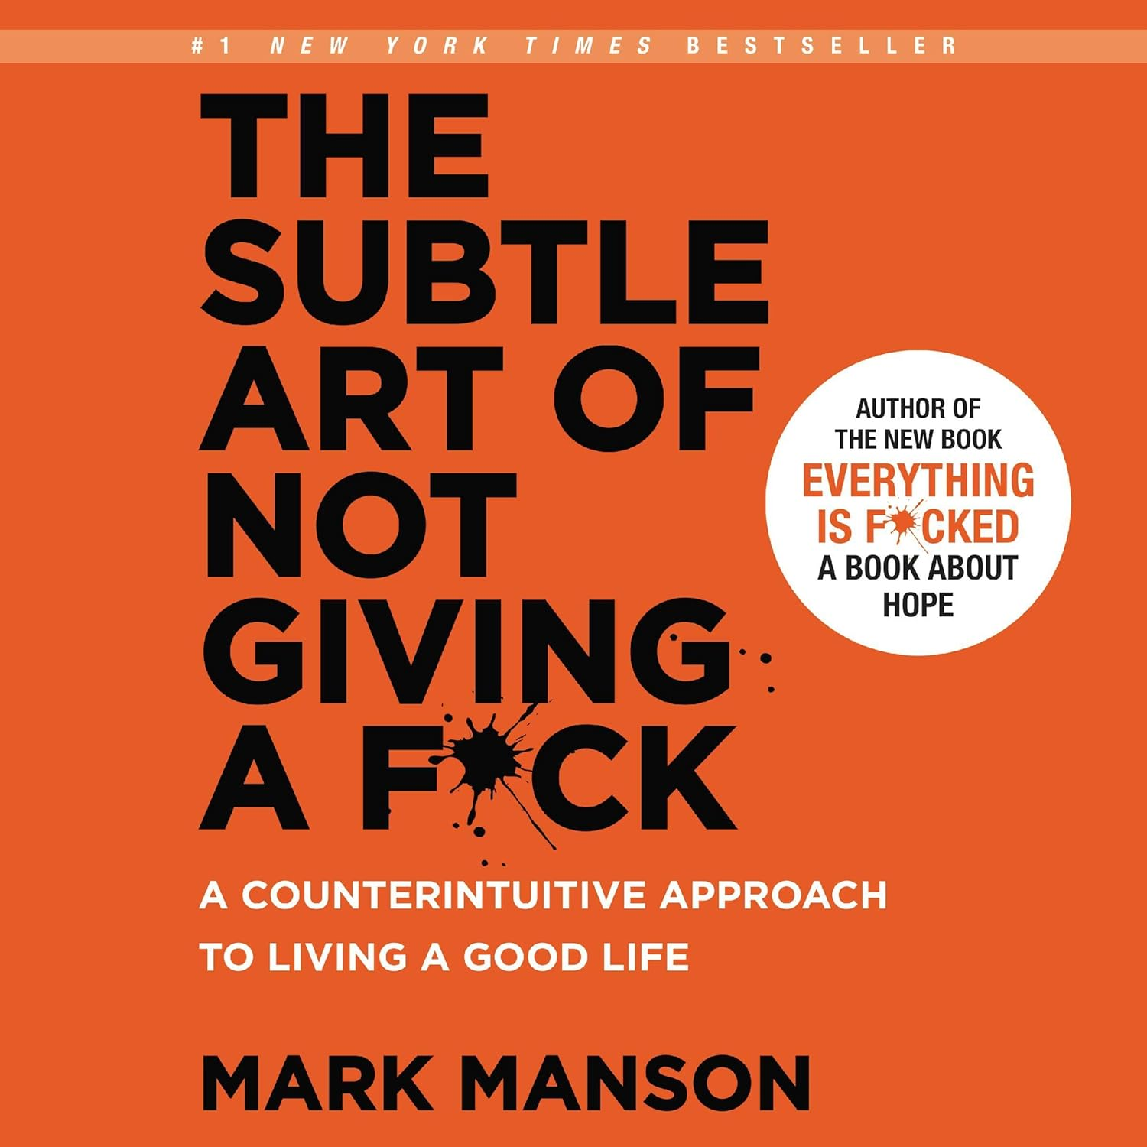
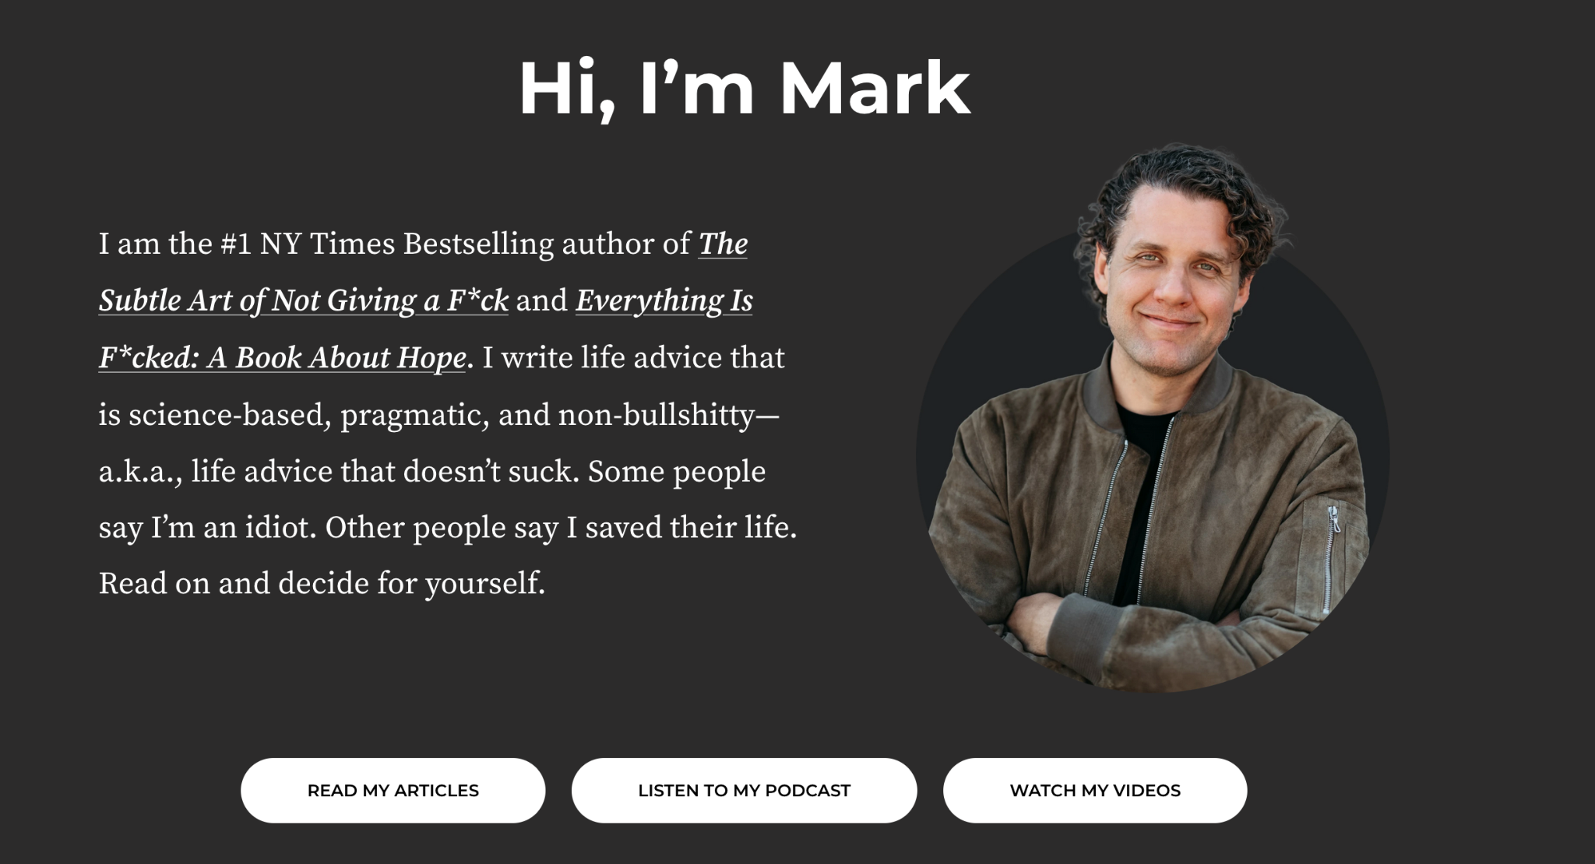
Ejercicio de escritura libre

Slide 6
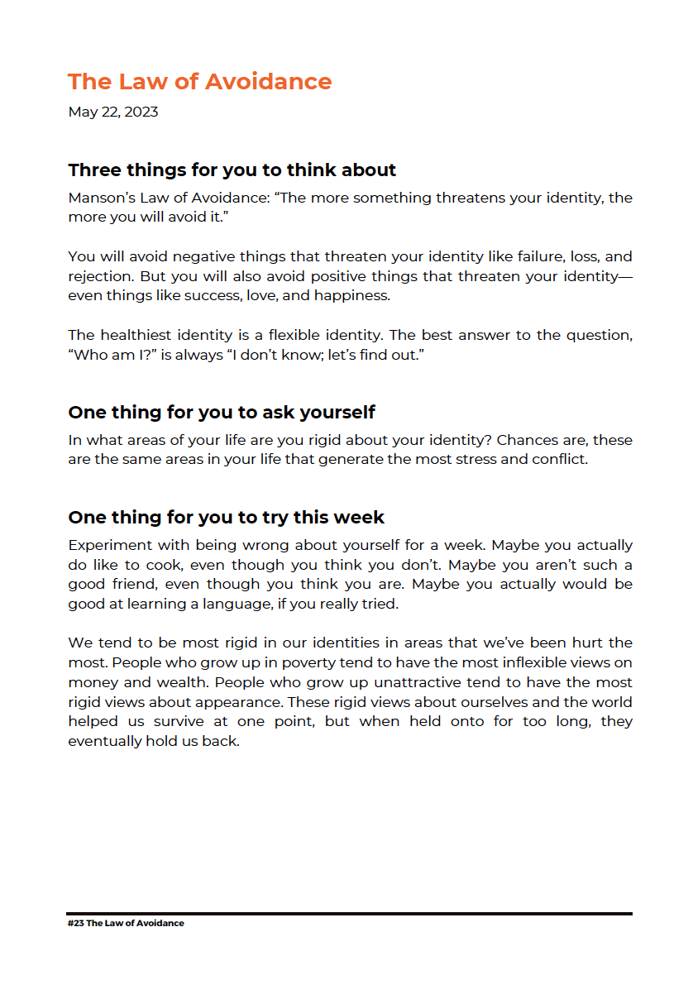

Ejercicio de escritura libre

Slide 7
Ejercicio de escritura libre
Law of avoidance:
“The more that something threatens your identity, the more you’ll avoid it”.

Slide 8
Ejercicio de escritura libre
Law of avoidance:
“The more that something threatens your identity, the more you’ll avoid it”.
Negative stuff
Failiure
Lost
Rejection

Slide 9
Ejercicio de escritura libre
Law of avoidance:
“The more that something threatens your identity, the more you’ll avoid it”.
Negative stuff
Positive stuff
Failiure
Lost
Rejection
Success
Love
Happyness

Slide 10
The healthiest identity is a flexible, open one. The best answer to the question "¿Who am I?" Is always "I don’t know; lets find out".
Mark Manson

Slide 11
Excercise (free writing again)
As a researcher, what kind of identity have you constructed for yourself?
Do you see that identity as fixed or flexible?
What ideas or beliefs—positive or negative—shape your identity as a researcher?
“I’m not creative.” / “I’m really good at writing academic papers.” / “My style is too simple.” / “I could never write a book.”
What if you were wrong about the fixed identity you’ve created for yourself? How might these beliefs be limiting your writing process? What if you actually are creative? What if you could write in different styles, but simply haven’t experimented with them enough?
What new possibilities might open up if you stopped holding so tightly to fixed beliefs about your research?

Slide 12

One thing to try this week:
Spend a week experimenting with the possibility that you might be wrong about yourself. Maybe you actually do enjoy cooking, even if you think you don’t. Maybe you’re not as good a friend as you think you are. Maybe you could be good at learning a language if you really gave it a try.
Maybe you do enjoy academic writing.
Maybe you can write poetry.
Maybe finishing your thesis isn’t as hard for you as you think.

